Slide 1
Cardiac output
Dr.Deepa.G.S
Associate Professor
SKHMC

Slide 2
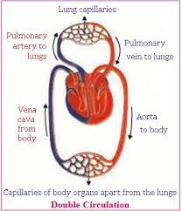
Cardiac output
Cardiac output is the amount of blood pumped from each ventricle
5 litre/min

Slide 3
Usually, cardiac output is expressed in three ways:
1. Stroke volume
2. Minute volume
3. Cardiac index.

Slide 4
STROKE VOLUME
Stroke volume is the amount of blood pumped out by each ventricle during each beat.
Normal value: 70 mL (60 to 80 mL) when the heart rate is normal (72/minute).
End diastolic volume = 120-140 ml
End systolic volume = 50-70 ml
Stroke volume = EDV-ESV= 70 ml

Slide 5
MINUTE VOLUME
Minute volume is the amount of blood pumped out by each ventricle in one minute.
It is the product of stroke volume and heart rate:
Minute volume = Stroke volume × Heart rate
Normal value: 5 L/ventricle/minute.


Slide 6
CARDIAC INDEX
Cardiac index is the minute volume expressed in relation to square meter of body surface area.
It is defined as the amount of blood pumped out per ventricle/minute/ square meter of the body surface area.
Normal value: 2.8 ± 0.3 L/square meter of body surface area/minute (in an adult with average body surface area of 1.734 square meter and normal minute volume of 5 L/minute).

Slide 7
EJECTION FRACTION
Ejection fraction is the fraction of end diastolic volume that is ejected out by each ventricle. Normal ejection fraction is 60% to 65%.

Slide 8
CARDIAC RESERVE
Cardiac reserve is the maximum amount of blood that can be pumped out by heart above the normal value.
Cardiac reserve is usually expressed in percentage.
In a normal young healthy adult, the cardiac reserve is 300% to 400%.
In old age, it is about 200% to 250%.
It increases to 500% to 600% in athletes.
In cardiac diseases, the cardiac reserve is minimum or nil

Slide 9
PHYSIOLOGICAL VARIATIONS
PHYSIOLOGICAL VARIATIONS
1. Age: In children, cardiac output is less because of
less blood volume. Cardiac index is more than that
in adults because of less body surface area.
2. Sex: In females, cardiac output is less than in males
because of less blood volume. Cardiac index is
more than in males, because of less body surface
area.
3. Body build: Greater the body build, more is the
cardiac output.

Slide 10
PHYSIOLOGICAL VARIATIONS
4. Diurnal variation: Cardiac output is low in early
morning and increases in day time. It depends
upon the basal conditions of the individuals.
5. Environmental temperature: Moderate change in temperature does not affect cardiac output. Increase in temperature above 30°C raises cardiac output.

Slide 11
PHYSIOLOGICAL VARIATIONS
6. Emotional conditions: Anxiety, apprehension and excitement increases cardiac output about 50% to 100% through the release of catecholamines, which increase the heart rate and force of contraction.
7. After meals: During the first one hour after taking
meals, cardiac output increases.
8. Exercise: Cardiac output increases during exercise
because of increase in heart rate and force of
contraction.

Slide 12
PHYSIOLOGICAL VARIATIONS
9. High altitude: In high altitude, the cardiac output increases because of increase in secretion of adrenaline.
Adrenaline secretion is stimulated by hypoxia (lack of oxygen).
10.Posture: While changing from recumbent to uprightposition, the cardiac output decreases.

Slide 13
PHYSIOLOGICAL VARIATIONS
11. Pregnancy: During the later months of pregnancy, cardiac output increases by 40%.
12. Sleep: Cardiac output is slightly decreased or it is unaltered during sleep.

Slide 14
PATHOLOGICAL VARIATIONS
Increase in Cardiac Output
Cardiac output increases in the following
conditions:
1. Fever: Due to increased oxidative processes
2. Anemia: Due to hypoxia
3. Hyperthyroidism: Due to increased basal metabolic rate

Slide 15
PATHOLOGICAL VARIATIONS
Decrease in Cardiac Output
Cardiac output decreases in the following conditions:
1. Hypothyroidism: Due to decreased basal metabolic rate
2. Atrial fibrillation: Because of incomplete filling of ventricles
3. Incomplete heart block with coronary sclerosis or
myocardial degeneration:
Due to defective pumping action of the heart

Slide 16
PATHOLOGICAL VARIATIONS
4. Congestive cardiac failure: Because of weak
contractions of heart
5. Shock: Due to poor pumping and circulation
6. Hemorrhage: Because of decreased blood volume.

Slide 18
FACTORS MAINTAINING CARDIAC OUTPUT
Cardiac output is maintained (determined) by
four factors:
1. Venous return
2. Force of contraction
3. Heart rate
4. Peripheral resistance.

Slide 19
Venous return
Venous return in turn, depends upon five
factors:
i. Respiratory pump
ii. Muscle pump
iii. Gravity
iv. Venous pressure
v. Sympathetic tone.

Slide 20
Respiratory Pump

Slide 21
Muscle pump

Slide 22
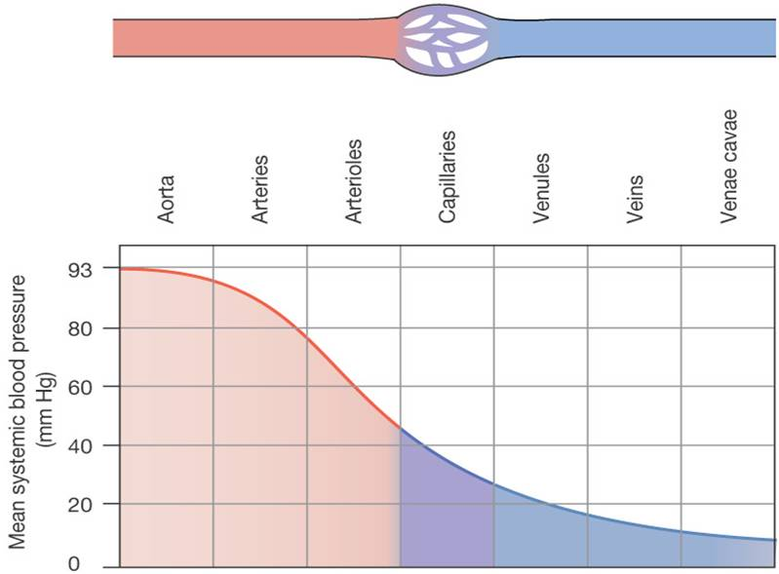
Systemic blood pressure

Slide 23
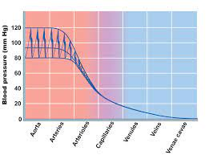
Systemic blood pressure
Microsoft PowerPoint - Presentation1 [Compatibility Mode] (linnbenton.edu)

Slide 24
https://www.youtube.com/watc?v=bzzeYMxY4Ms
https://www.youtube.com/watch?v=bzzeYMxY4Ms

Slide 25
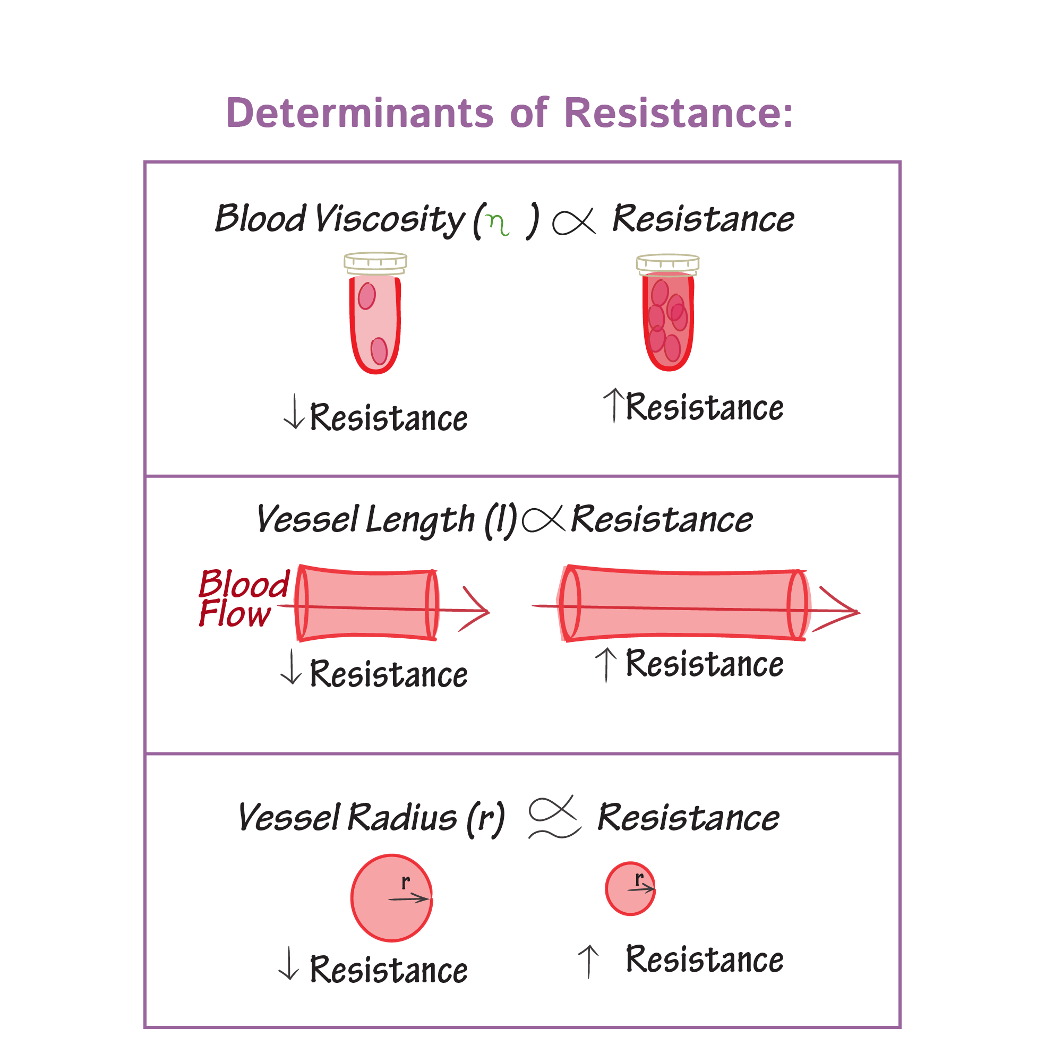
Vascular Resistance - Physiology Flashcards | Draw it to Know it

Slide 26
Measurement of cardiac output
Direct methods
By using flow meters
Mechanical
Electromagnetic
Ultrasound doppler

Slide 27
Indirect methods
1. By using Fick principle
2. Indicator (dye) dilution technique
3. Thermodilution technique
4. Ultrasonic Doppler transducer technique
5. Doppler echocardiography
6. Ballistocardiography.

Slide 28
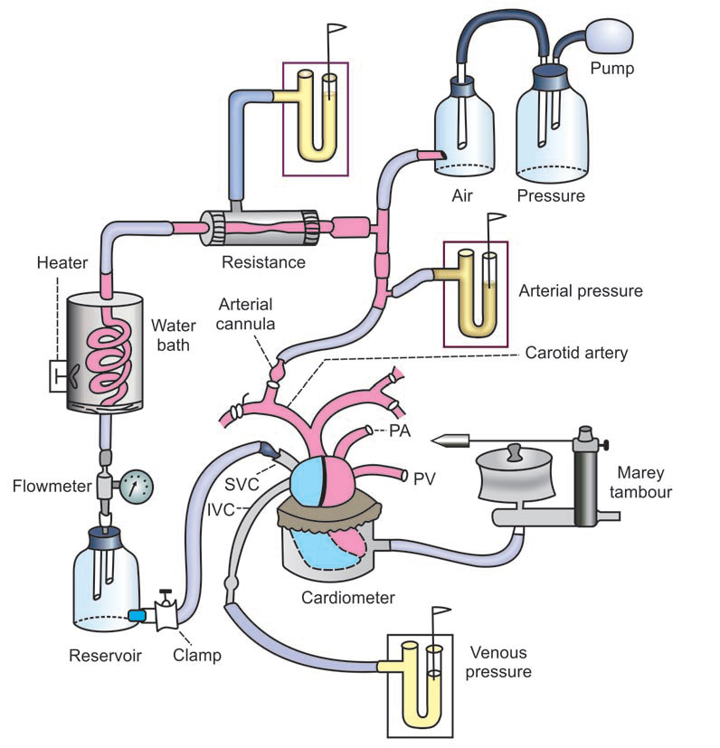

Slide 29
Electromagnetic flow meter

Slide 30
Electromagnetic flowmeter

Slide 31
Electromagnetic flowmeter
Generation of an electrical voltage in electrodes on a blood vessel when the vessel is placed in a strong magnetic field and blood flows through the vessel
Blood is a conductor, and when it moves through a magnetic field, a voltage is induced in it, which is proportional to its velocity.

Slide 32
ULTRASONIC DOPPLER FLOWMETER

Slide 33
A minute piezoelectric crystal is mounted at one end in the wall of the device.
This crystal, when energized with an appropriate electronic apparatus,transmits ultrasound at a frequency of several hundred
thousand cycles per second downstream along the flowing blood.
A portion of the sound is reflected by the red blood cells in the flowing blood.
The reflected ultrasound waves then travel backward from the blood cells toward the crystal.

Slide 34
reflected waves have a lower frequency than the transmitted wave because the red cells are moving away from the transmitter crystal.
This is called the Doppler effect.
frequency difference between the transmitted wave and the reflected wave, thus determine the velocity ofblood flow.

Slide 35
Disadvantages
i.Direct methods to measure cardiac output can
be used only in animals
ii.Blood vessel has to be cut open at the risk of
animal’s life
iii.While using cardiometer, the size of the
cardiometer must be suitable for the size of the
heart
iv.While using mechanical flowmeter, diameter
of inlet and the outlet of the flowmeter must be
equivalent to the diameter of the blood vessel

Slide 36
Fick’s Principle
Amount of substance taken or given =
Amount of blood flow/minute x Arteriovenous difference
Modified Fick’s principle
CO =Amount of substance taken or given by the oragn/min
Arteriovenous difference of the substance across the organ

Slide 37
CO= Oxygen consumed (in ml/min)
Arteriovenous Oxygen difference
Oxygen consumption – Respirometer
Oxygen content in arterial and venousblood- Blood gas analysis

Slide 38
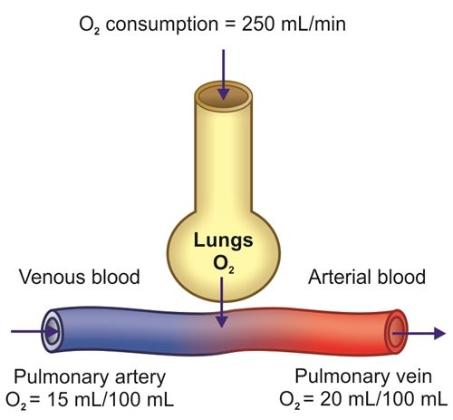
Fick’s mehod
CO= Oxygen consumed (in ml/min)
Arteriovenous Oxygen difference
CO= 250ml/min
20-15/100ml
=250 x 100
5
=5000 ml

Slide 40
Indicator dilution method

Slide 41
Indicator dilution method

Slide 42
Thermodilution method

Slide 43
Cardiac Catheterization

Slide 44
Echocardiogram

Slide 45
Echocardiogram

Slide 48
Atherosclerosis

Slide 49
Balloon angioplasty with stent

Slide 52
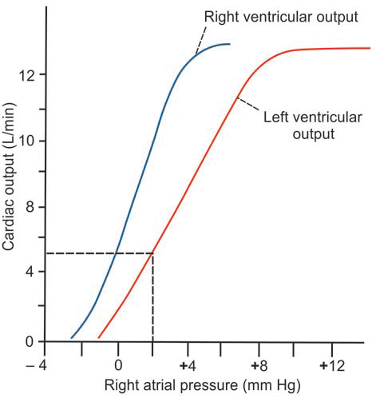
Cardiac function curves

Slide 53
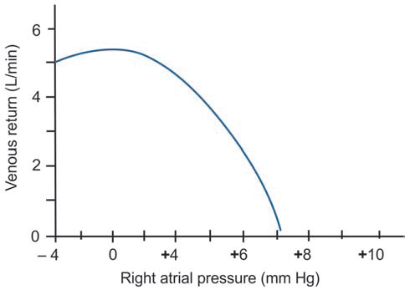
Venous return curve

Slide 54
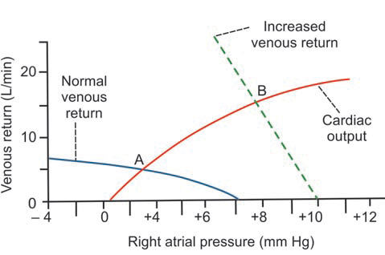
Cardiac function curves

Slide 55
Courtesy:
https://www.youtube.com/watch?v=bzzeYMxY4Ms
Essentials of Medical Physiology 6Th edition pdf by K.Sembulingam and Prema Sembulingam

